Slide 1
Chapter 3
Passive fiber components

Slide 2
1. Introduction
The fiber optic components can be broadly classified as follows:
Amplitude/intensity components
Couplers, Attenuators, Reflectors
Phase components
Phase shifters, Phase modulators
Polarization components
Polarizers, Polarization splitters, Polarization controllers
Wavelength components
Wavelength filters, Wavelength division multiplexers/demultiplexers
Frequency components
Frequency shifters, Filters

Slide 3
Passive fiber components
Definition：Don’t need any external drivers
Types：
Optical fiber connector; Optical fiber coupler；
Wavelength division multiplexer(WDM)
Optical attenuator；optical filter；
Optical insulator and circulator；
Polarizer, Fiber grating；etc
Active fiber components
Definition：Need external drivers
Types：
Fiber laser
Fiber amplifier
Optical wavelength converter(XGM,XPM,FWM)
Optical modulator
Optical switcher/ router

Slide 4
Analogy between optical components and electric components

Slide 5
Here, we focus on the some fiber components below
Self-focusing lens
Optical connector
Coupler
Isolator
Circulator
WDM
Fiber grating

Slide 6
Application of optical components
These components are widely applied in fiber communication systems
DWDM
Dispersion compensation component
Isolator
Circulator
DWDM
Coupler
Circulator
Connector
DWDM
Isolator
Coupler

Slide 7
These components are widely applied in fiber communication systems, fiber laser and fiber sensors.
Fiber laser (mode-locked fiber laser)

Slide 8
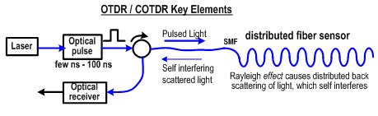
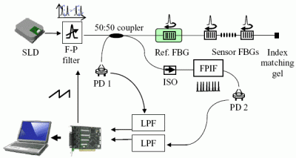
Fiber Sensor
Circulator, Connector
Connector, Coupler, FBG, Isolator

Slide 9
2. Self-focusing lens
(1) The application of self-focusing lens:
Collimating the light from fiber and coupling the free space light into fiber
Fiber
Fiber
Fiber
LD
Fiber

Slide 10
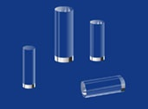
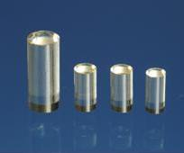
(2) Structure and mechanism of the self-focusing lens
The structure of the self-focusing lens is same as that of self-focusing fiber ( one type of graded index fiber).

Slide 11
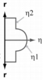
What is the self-focusing fiber?
Self-focusing fiber：fiber with square law index profile
light ray transmission trace is a sin curve the light rays are focused at a same point after a period
Parallel
Focused

Slide 12
self-focusing lens can be regarded as a section of self-focusing fiber.
Differences between them:
self-focusing lens have
larger core (~2mm)
shorter length (only 1~2 period)
larger NA (0.2~0.6)
different fabrication processes

Slide 13
Comparison of globe lens and self-focusing lens
1.Uniform refractive index profile
2. Imaging by bended interface
3. To improve the imaging quality by careful aspheric design thus removing the spherical aberration
1. Graded refractive index profile
2. Imaging based on the bended light ray trace
3. To improve the imaging quality by optimizing refractive index profile

Slide 14
Compared to conventional globe lens, the self-focusing lens has a series of advantages.
Advantages:
Tiny
Smooth surface and ease of optical processing
The focal length and imaging characteristic can be flexibly changed by varying its length and refractive index profile
Its aberration can be controlled by optimizing the refractive index profile

Slide 15
(3) Refractive index of self-focusing lens
Transmission trace of the light ray:
Self -focusing lens usually satisfies the square law index profile：
Compared to the fiber with a square law index profile：
thus
Δ——Relative refractive index；
a——Radius；
n₀——Refractive index at the fiber axis

Slide 16
(4) Types of self-focusing lens
(1) Collimating lens 准直透镜
Transforming the light from fiber to parallel light
(2) Coupling lens 耦合透镜
Coupling the light from LD or fiber to the other fiber.

Slide 17
An important parameter of self-focusing lens
Pitch (P)
It represents the transmission period of the light.
Any input light rays can be also transformed to parallel light rays by carefully adjusting P.
P

Slide 18
Collimating lens
fiber
The fiber is placed at the focal point of the self-focusing lens

Slide 19
Collimating lens
0.25P lens

Slide 20
For 0.25 P lens:
Beam width is proportional to NA, and the divergence is to fiber radius.
e.g.
Single mode fiber (NA=0.1, a=10 um), beam width=0.67 mm, beam divergence=1.5×10⁻³ rad
Multimode fiber (NA=0.2, a=50 mm), beam width=1.33 mm, beam divergence=7.5×10⁻³ rad

Slide 21
Coupling lens
fiber
Light source
a_{s}, NA_{s}
a_{out}
l
θ_{out}
l is the distance between the source and the end face of the lens, a_{out} is
the maximum spot radius of the output beam from the lens, θ_{out} is the flare
angle of the output beam from the lens, a_{s} is the beam radius of the source,
NA_{s} corresponds to the numerical aperture of the source.

Slide 22
Coupling lens
fiber
fiber
Coupling light from one fiber to the other fiber

Slide 23
Coupling lens
0.23P lens

Slide 24
Coupling lens
LD
fiber
Coupling light from LD to fiber

Slide 25
0.29P lens

Slide 26
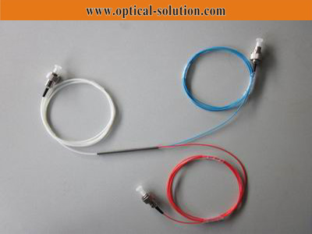
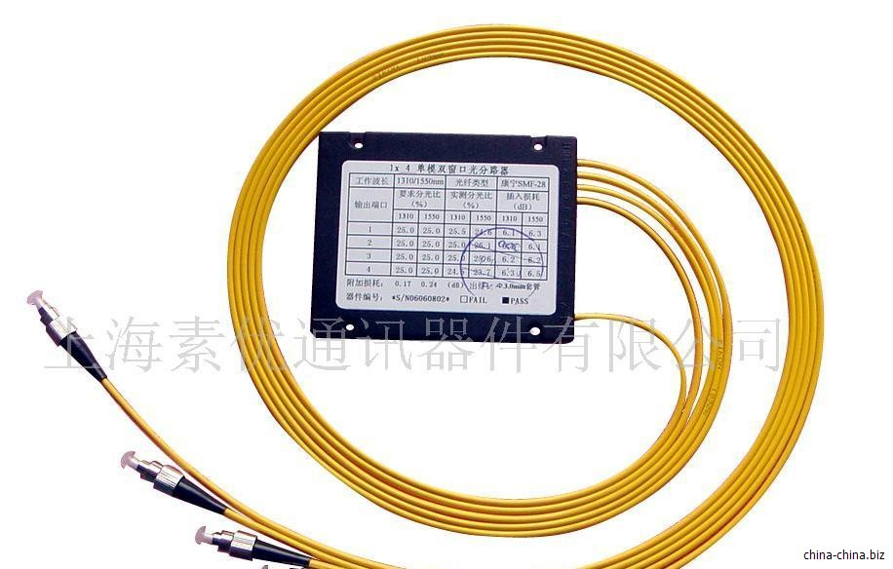
2. Fiber directional coupler
Introduction
Coupler:
It is a passive component used for dividing the signals, and is one of the most important in-line fibre components.The light is inputted from one port and then outputted from another one or more ports.

Slide 27
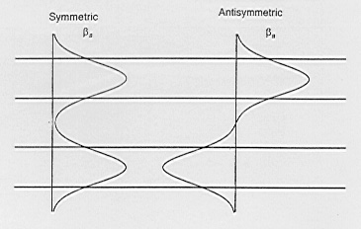
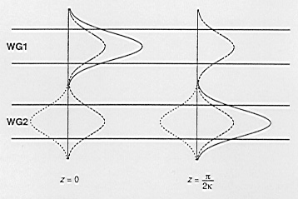
The operation principle of coupler [定向耦合器原理]
Single mode fiber：modes coupling theory；
Multimode fiber：bending theory.
Mechanism：when two fibers are closer, the waveguide field of one fiber will polarize the other fiber thus inducing the guided modes, therefore the fields overlap.
Directional coupler - formed by a pair of identical symmetric single-mode planar waveguides
At z = 0, power launched into WG1, exciting symmetric and antisymmetric modes
Two modes developing a phase difference, Δφ, as they propagating
Δφ = π, the superposition cancelling in WG1 and adding in WG2
Δφ = 2π, leading to a power transfer back to WG1
Power exchanging periodically between WG1 and WG2

Slide 28
Power exchange
If P₁(0) is the power launched into fiber 1 at z = 0, then the power propagating in the two fibers are
κ – coupling coefficient, a measure of the interaction strength between the two fibers, depending on
fiber parameters
separation between the fiber cores
operation wavelength

Slide 29
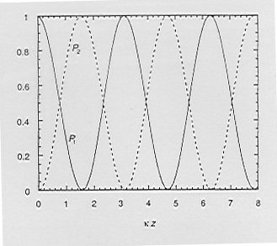
(i)
(ii)
no coupling between two fibers – no exchange of power
Phase-match case
A coupler made up of two identical fibers
Variation of powers in the two fibers in a directional coupler as a function of z when the two fibers β₁=β₂.

Slide 30
Interaction length L_{c}
The minimum distance at which the power completely transferred from the input fiber to the other fiber.
For typical single mode fibers operating at 1.3mm
κ ~ 0.8 mm⁻¹ to 0.3 mm⁻¹
L_{c} ~ 2-5 mm
3-dB (50%) coupler:
By appropriately choosing the value of κ⋅L, we can fabricate couplers with an arbitrary splitting ratio.

Slide 31
Practical parameters of a coupler
① Coupling ratio
The ratio of the input power at the port i to the output power from the port j
② Excess loss
The ratio of the total output power from all the ports to the input power at the port i

Slide 32
③ Insertion loss
The ratio of the output power from the port j to the input power at the port i
④ Directivity：方向性
The ratio of the output power from the undesired port k to the input power from the port i

Slide 33
Good directional couplers should have low excess loss and high directivity.
Commercial directional couplers:

Slide 34
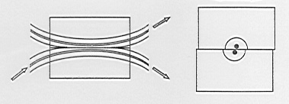
Fabrication of directional couplers
(a) Polished fiber couplers
Fiber directional coupler made up of two side-polished fiber half blocks. Tuning is achieved by one lock against the other.
Standard technique for PM fiber couplers;
Disadvantage: time-consuming operation, high cost.

Slide 35
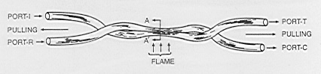
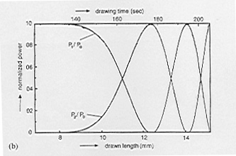
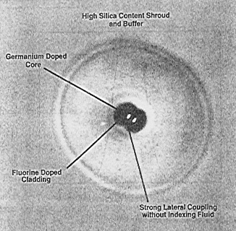
(b) Fused couplers 熔铸耦合器
Fused couplers —— fabricated by twisting two single-mode fibers (after removing their protective coating) and then heating and pulling them - two fibers fused laterally with one another and also tapered
Experimentally measured normalised power exiting the two fibres versus the drawn length.

Slide 36
The coupling ratio is monitored on line as the fibers are fused and drawn.
Fused fiber couplers widely used for WDM network systems.
Loss < 0.1dB with directivity in excess of 55dB.[超过]

Slide 37
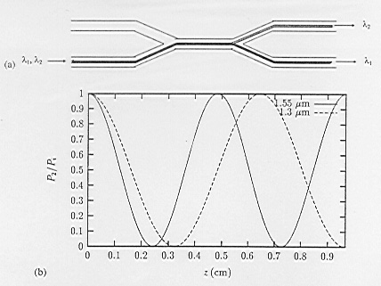
Applications
(a) Power dividers - one of the most important and common applications.
(b) Wavelength division multiplexer/demultiplexer
Multiplexer principle:
Considering a directional coupler of length L made of identical fibers and κ₁ and κ₂ be the coupling coefficients at wavelengths λ₁ and λ₂

Slide 38
In such a case, if light beams λ₁ and λ₂ are launched simultaneously in the input fiber
λ₁ exiting port B; λ₂ exiting port A - wavelength demultiplexing
1.3 mm / 1.55 mm WDM:
If light of 1.55 mm and 1.3 mm launched on the same fiber at the input of the coupler, light 1.3 mm will exit from the same fiber, whereas light 1.55 mm will exit from the other fiber.

Slide 39
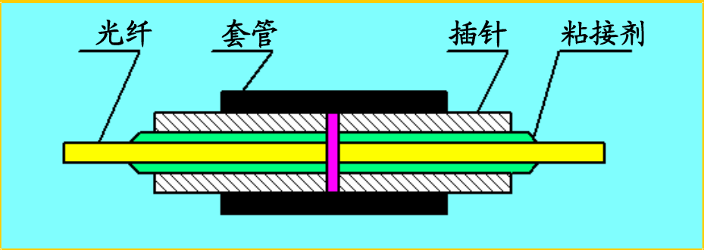
3. Fiber-optic connectors
What is fiber-optic connector?
An optical fiber connector terminates端接/终止 the end of an optical fiber, and enables quicker connection and disconnection than splicing.
The typical structure of a fiber-optic connector
Fiber
Tube
ferrule
Glue

Slide 40
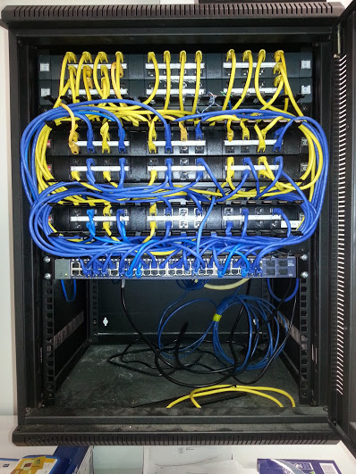
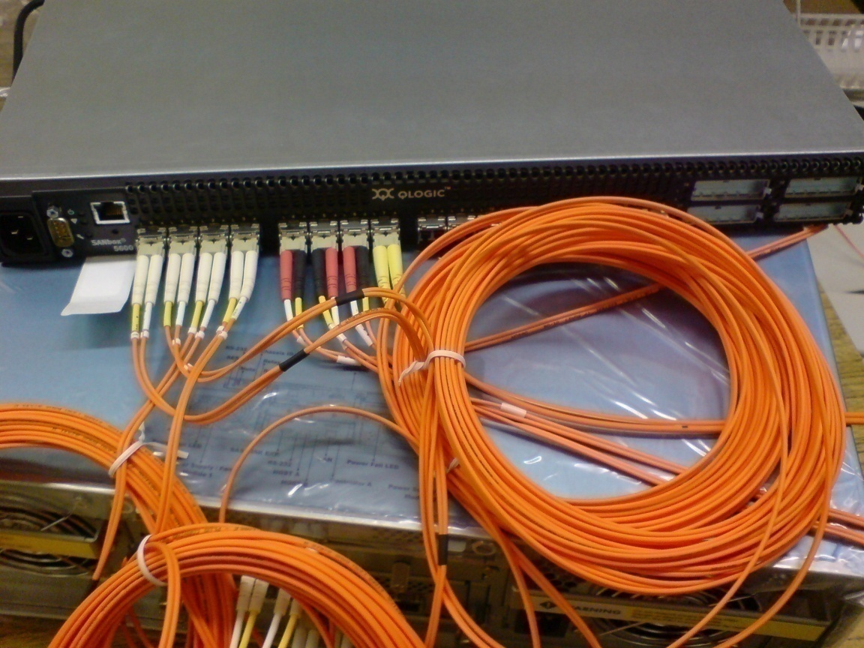
The application of fiber-optic connector
It is usually applied in the connection between fibers, equipments, or fiber and equipment.

Slide 41
The performance of the fiber-optic connector
Optical loss
Insertion loss
Return loss
(2) Interchangeability 互换性
(3) Tensile strength 抗张强度
(4) Temperature
(5) Lifetime

Slide 42
Optical loss
Insertion loss
Introduction by the connector
Typically <0.5 dB.
Return loss [越大越好]
It describes the ability of the connector to restrain the reflection
Typically larger than 25 dB.
If the polish is performed, it can be improved to larger than 45 dB.

Slide 43
(2) Interchangeability
For the same type connectors, they can be replaced arbitrarily.
(3) Tensile strength
It is usually larger than 90 N.
(4) Temperature
Normally operates at the temperature range of
-40⁰C~70⁰C.
(5) Lifetime
Good connector is required to be plugged beyond 1000 times.

Slide 44
Types of fiber-optic connector
There are a series of different classification standards.
fiber materials
structures
shapes of the fiber ends
numbers of the fiber cores
……

Slide 45
Silica fiber based connectors (including single mode and multimode fibers)
Connectors with different fiber materials
Plastics fiber based connector
……
FC connector(fiber channel)
(screw thread connection)
ST connector
(bayonet socket connection)
Connectors with different structures
SC connector
(snap-in)
MT connector
(multifiber)
……

Slide 46
PC connector
(the connector surface is slightly curved)
Connectors with different shapes of the fiber ends
APC connector
(the endface is at an 8 degree angle)
……
Single core connector
Connectors with different numbers of the fiber cores
Multi core connector
……

Slide 47
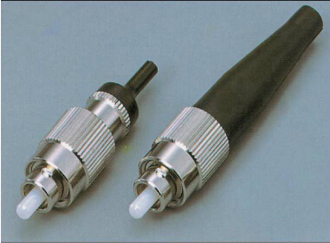
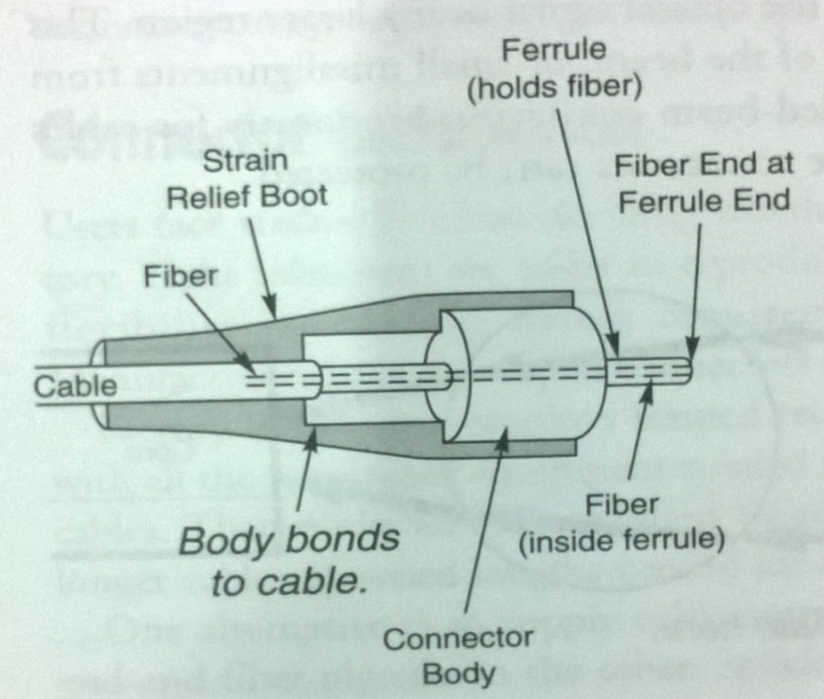
The commonly used fiber-optic connectors
(1) FC connector
This type of connectors are widely applied in datacom, telecommunications, measurement equipment, and EDFA
Typical structure of the FC connector
The fiber is mounted in a long, thin cylinder called a ferrule which is typically made of ceramic and with 2.5 mm diameter.

Slide 48
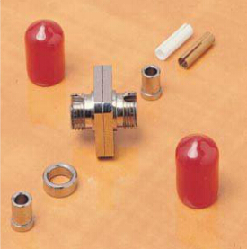
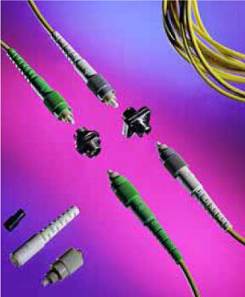
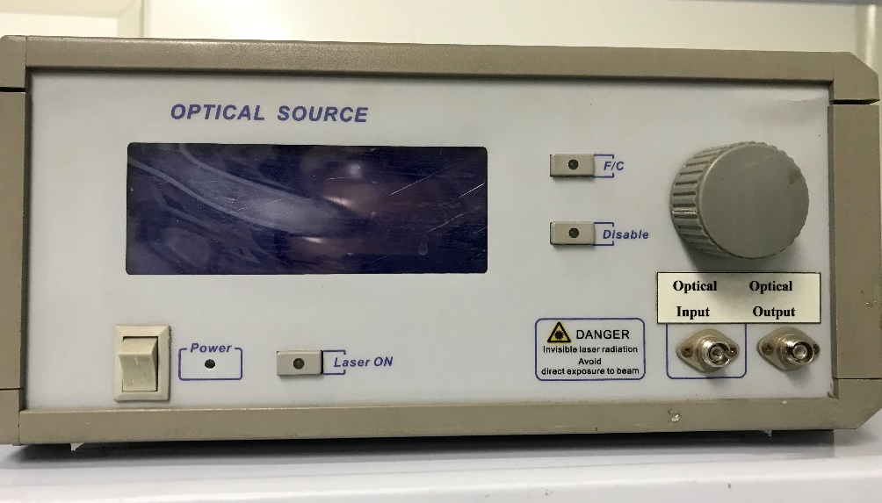
FC connector is connected with the help of the screw thread. 螺纹
FC connector is simple with an easy operation and fabrication, but the fiber end is sensitive to dust.

Slide 49
The commonly end type of the FC connector
(1)FC/FC
Flat Contact (FC). A back reflection of about -16 dB (4%).
(2)FC/PC
Physical Contact (PC). A slightly curved end surface and a back reflections of -30 to -40 dB.
Question: Why is the angle is 8⁰?
(3)FC/APC
8⁰
Angled PC (APC) adds an 8⁰ angle to the end surface. A back reflections of <-60 dB can routinely be accomplished with this polish

Slide 50
Question: Why is the angle is 8⁰?
Because when the end face of the APC connector is inclined by 8 degrees, the return loss will be higher than that of the plane.
This kind of oblique 8 degree fiber patch cord is mainly used in analog transmission, high-power ports and other places that are particularly sensitive to end-face reflection, and its advantage is that the end-face reflection is small and the return loss is large. The return loss of the general PC or UPC jumper is 50~55dB, and the APC is generally 60~65dB. But this does not mean that there is no reflection at all, but the reflection is particularly small.

Slide 51
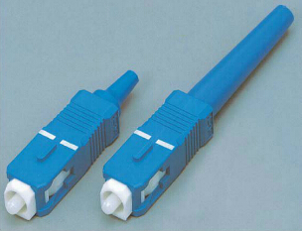
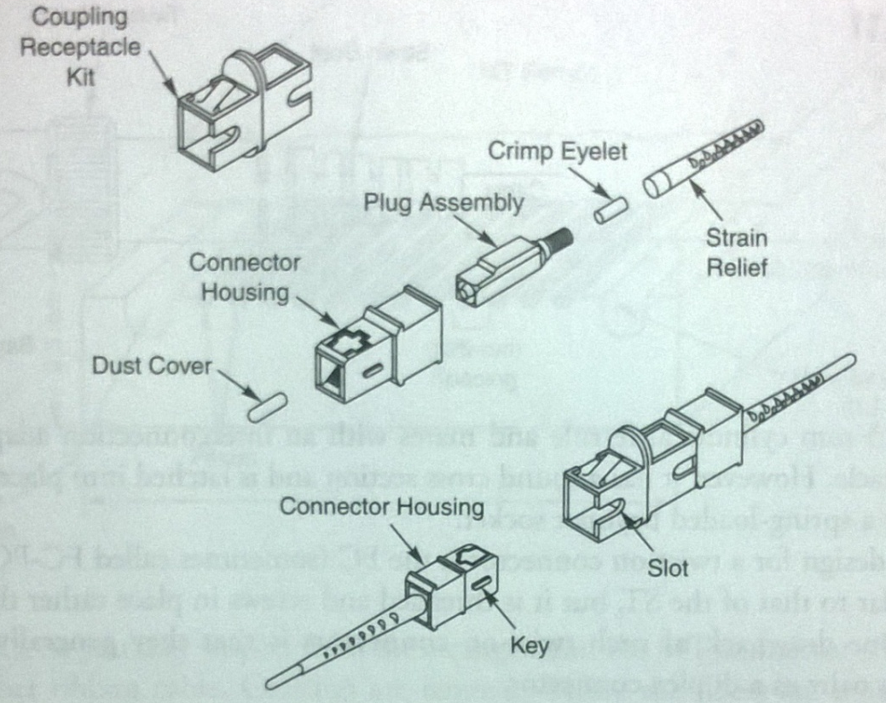
(2) SC connector
This type of connectors are widely applied in the Router and Switch.
Typical structure of the SC connector
SC connector is built up around a cylindrical 2.5 mm ferrule that holds the fiber.

Slide 52
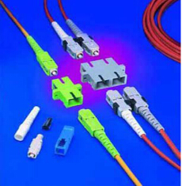
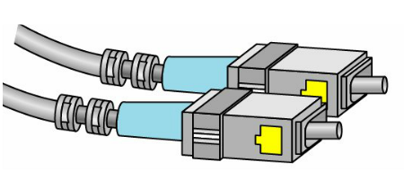
The cross section of the outermost shell is rectangular.
It is fastened using the rectangular latch and cannot be rotated.
This type of connectors can be divided into the simplex type and duplex type.

Slide 53
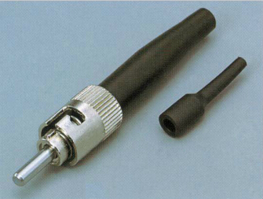
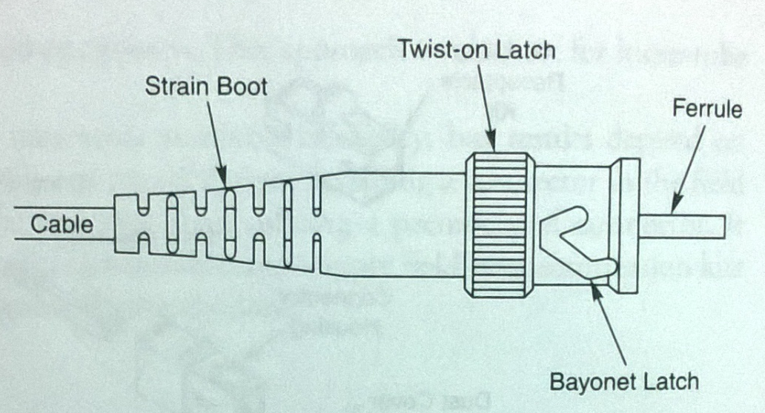
(3) ST connector
This type of connectors are widely applied in the 10-Mbps Ethernet system.
ST connector is similar to the SC connector.
It has a 2.5 mm ferrule made up of metal.
It is fastened by a bayonet latch.
It is only simplex.
Typical structure of the ST connector

Slide 54
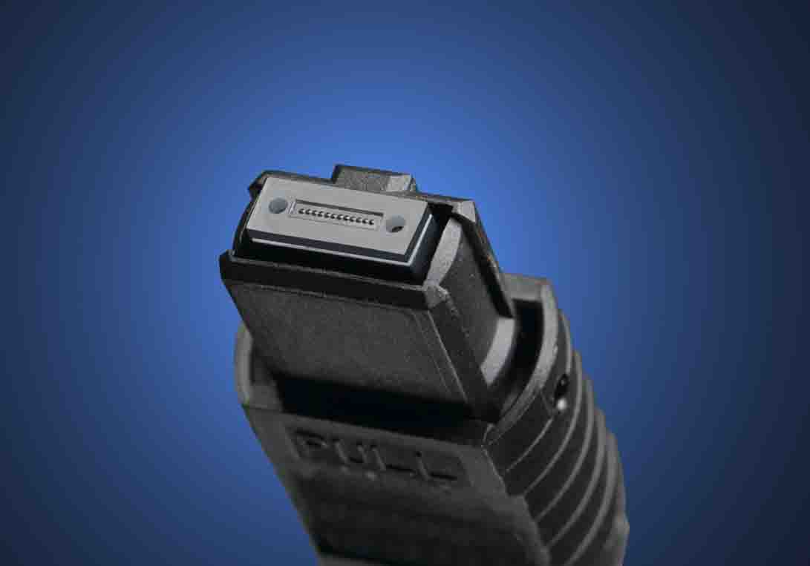
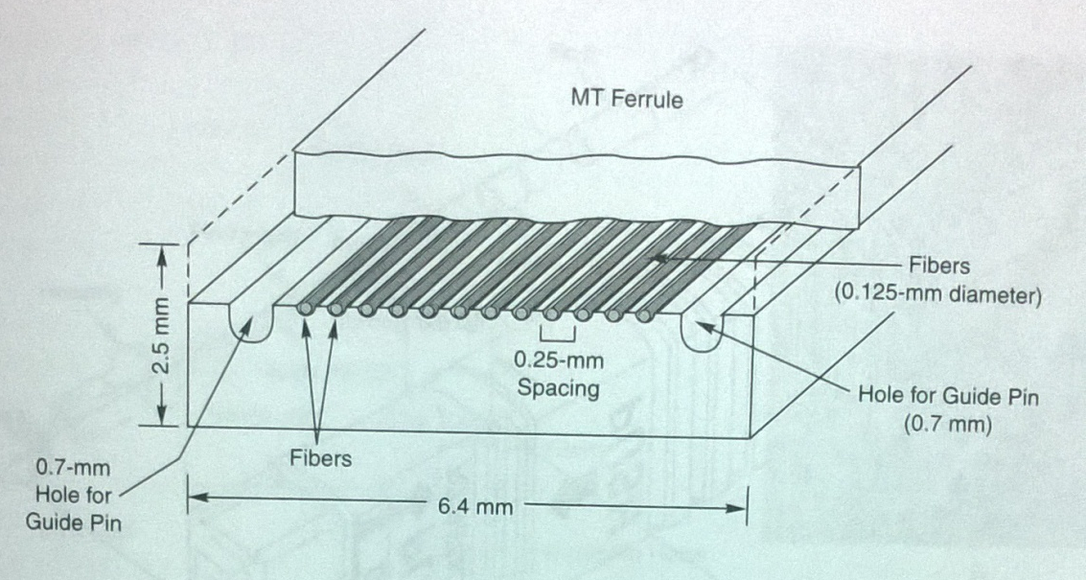
(4) MT connector
Typical structure of the MT connector
This type of connector area widely applied in the multichannel signal transmission system.
It is built up around the non-cylindrical ferrule which aligns many fibers parallel to each other.
The ferrules include a pair of 0.7-mm holes, parallel to fibers (Guide Pin).
These holes accommodate precision metal guide pins, which align the two elements with matched fibers

Slide 55
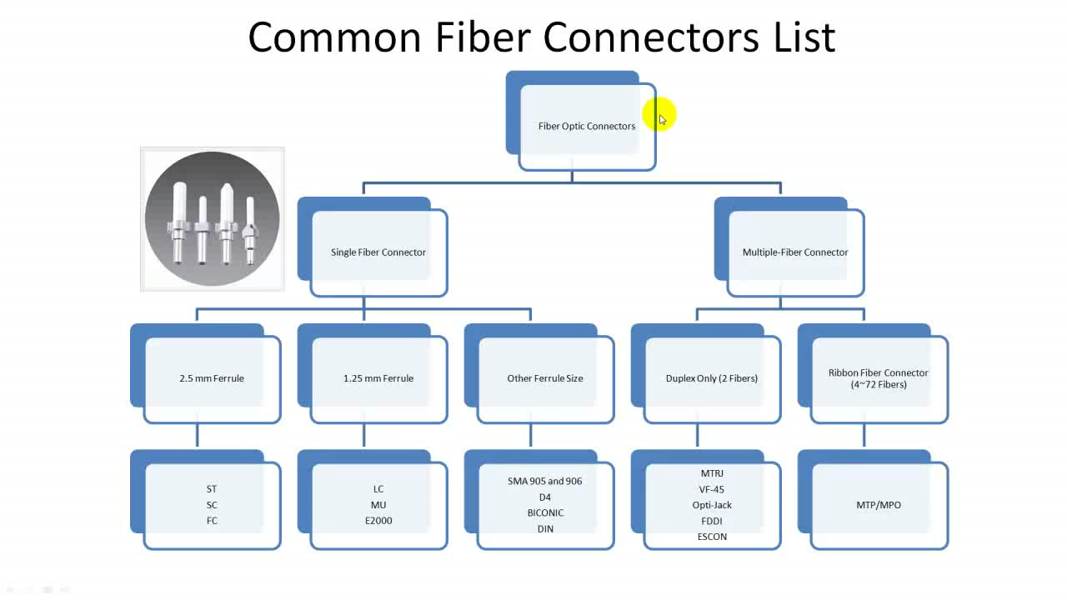

Slide 56
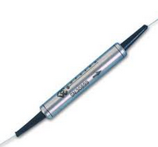
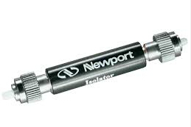
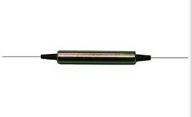
4. Fiber optic isolator
What is fiber optic isolator?
It is a fiber optic component that only allows the transmission of light in only one direction.
The light is completely blocked in the other direction.
Allow
Block

Slide 57
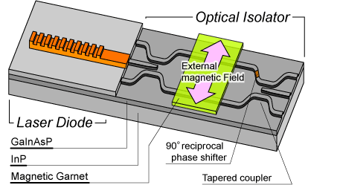
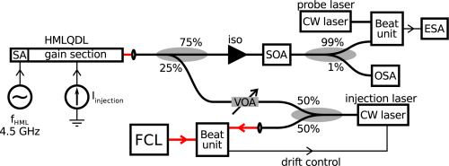
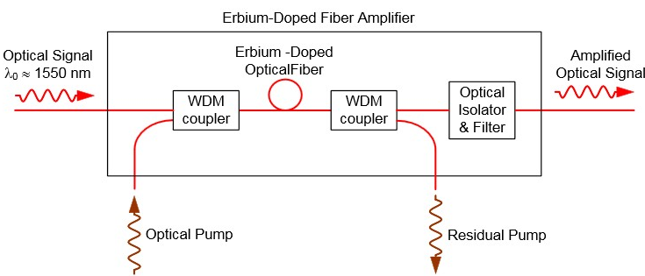
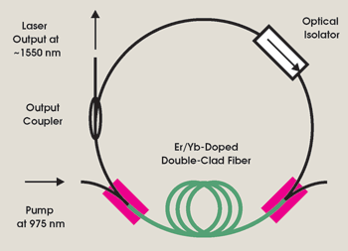
Application
①To avoid the feedback in the semiconductor laser thus reduce the error rate ；
②To avoid the returned light in a semiconductor amplifier thus improve the stability；
③Rare earth ions doped fiber amplifier（e.g., EDFA）；
④To ensure the unidirectional operation of the fiber lasers

Slide 58
The inside structures of fiber optic isolators
There are two types of typical fiber optic isolators:
Polarization dependent isolator (PDI)
Only available for special linearly polarization light.
(2) Polarization independent isolator (PIDI)
Available for the light with random polarizations.

Slide 59
(1) Polarization dependent isolator (PDI)
It consists of
1) a pair of polarizing filters whose polarization directions have an angle of 45⁰
2) a Faraday rotator.
Magnet ring

Slide 60
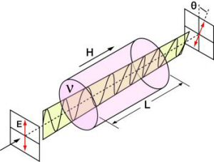
偏振旋转 右手定则
Faraday magneto-optical effect
Principle
Light transmits through the Faraday rotator in a magnetic field.
Polarization of the light always rotates along the right–hand–thread direction with respect to the magnetic field H.
The rotation direction is not relative to the light transmission direction.
The rotation angle θ is only related to the magnetic intensity H, Faraday rotator length L and material Verdet constant v
Basic Material:
Yttrium-Iron-Garnet (YIG), Corning No.8363 Glass, etc.

Slide 61
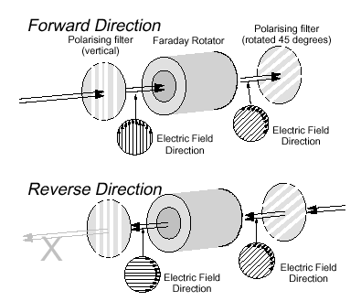
In a fiber optic isolator, the rotation angle θ is chosen to be 45º
顺时针转
Forward：the polarization direction rotates 45⁰ thus being parallel to the second polarizing filter, therefore the light transmission is allowed.
Reverse：the polarization direction rotates 45⁰ but being perpendicular to the second polarizing filter, therefore the light transmission is blocked.

Slide 62
Disadvantages of the PDI:
It is polarization dependent.
For the input light with the random polarization states, there is a 50% optical power loss
If the input light has a fixed polarization state, the optical power maybe lost totally.
If the polarization state varies as time, the light will also experience the loss. 损耗也会随时间变化

Slide 63
(2) Polarization independent isolator (PIDI)
It consists of
1) a pair of birefringent wedges
2) a Faraday rotator.
Faraday rotator
Birefringent wedge
Birefringent wedge

Slide 64
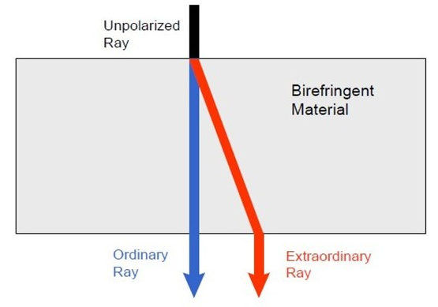
What is the briefingence?
For some birefringent materials, there would be different refractive indexes for the perpendicularly polarized lights.
They have a lower refractive index for the o ray and a higher refractive index for the e ray.
正单轴晶体Positive uniaxial crystal / 负Negative uniaxial crystals
The polarizations are specially separated.

Slide 65
For the forward light
o
e
o
e
o
e
Birefringent wedge I
Faraday rotator
Birefringent wedge II
The input light is separated into o beam and e beam by the birefringent wedge I.
Both beams are rotated 45º by the Faraday rotator.
The two beams are combined to be a single beam by the birefringent wedge II.
The forward light is allowed.

Slide 66
For the backward light
e
o
o
o
e
e
o
e
Birefringent wedge I
Faraday rotator
Birefringent wedge II
The input light is also separated into o beam and e beam by the birefringent wedge II.
Two beams are rotated 45º by the Faraday rotator.
The o beam becomes the e beam, the e beam becomes the o beam for the birefringent wedge I.
The two beams are diverged after passing through the birefringent wedge I
The backward light is blocked

Slide 67
The performance parameters of the fiber optic isolators
Insertion loss： a = -10lg (P_{out}/P_{in} ) (forward)
Isolation ratio： I = -10lg(P’_{out}/P’_{in}), (backward）
Return loss： I_{b} = -10lg(P_{back}/P_{in})
Operation bandwidth： Dl
For a commercial fiber optic isolator (Item: IO-H-1550)
Insertion loss： 0.5-0.7 dB
Isolation ratio： ≥29 dB
Return loss：≥55 dB
Operation bandwidth：40 nm

Slide 68
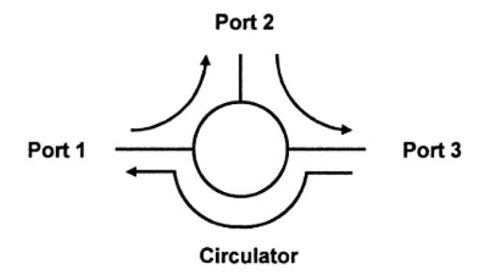
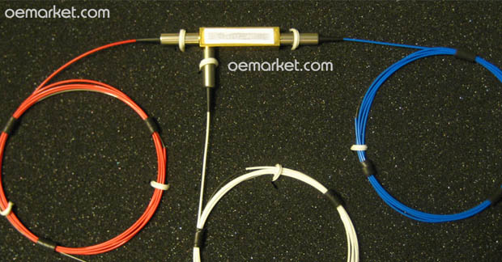
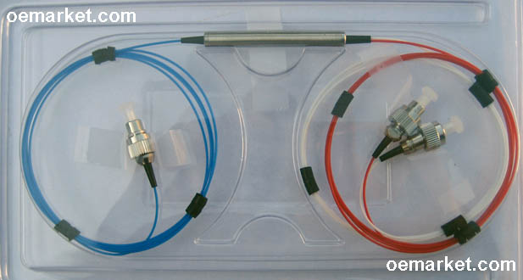
5. Fiber optic circulator
What is fiber optic circulator?
It is a fiber optic component that allows the light to transmit along the required path in order.
Port 1 →Port 2 → Port 3
Port 3到Port 1也有，但一般不会用

Slide 69
Application
1
2
3
Dispersion compensation combined with CFBG
Total reflection mirror

Slide 70
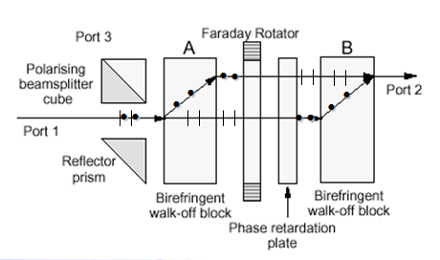
Port 1 →Port 2
Half wavelength plate 半波片
The light is separated into two perpendicular beams by the block A.
The polarizations of the two beams are rotated 90º after passing through 45º Faraday rotator and phase retardation plate.
The two beams are combined by the block B thus outputted from port 2.

Slide 71
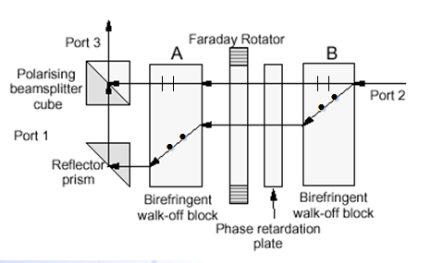
Port 2 →Port 3
Half wavelength plate
Light is separated into two perpendicular beams by the wedge B.
The polarizations of the two beams are kept unchanged after passing through 45º Faraday rotator and phase retardation plate.
The two beams are combined by the reflector prism and the polarizing beam splitter cube thus outputted from port 3.

Slide 72
The performance parameters of the fiber optic circulators：
Insertion loss： a = -10lg (P_{2,3}/P_{1,2} ), (order)
Isolation ratio： I = -10lg(P_{1,2}/P_{2,3}), (reverse order）
Return loss： I_{b} = -10lg(P_{back}/P_{in})
Operation bandwidth： Dl
For a commercial fiber optic circulator (Item: 6015-3)
Insertion loss： 0.8 dB
Isolation ratio： ≥40 dB
Return loss：≥50 dB
Operation bandwidth：85 nm

